Slide 1


Developing mediation skills:
Explaining data
1.5°C: what it means and why it matters

Slide 2
In this and coming lessons you’re going to …
Discuss mitigating climate change
Interpret charts, graphs and infographics
Watch videos
Explain data in writing

Slide 3
Developing your spoken mediation skills:
Collaborating in &/or leading a group
Can you collaborate on a shared task: helping define goals, asking questions to stimulate discussion, focus or re-focus a discussion with suggestions and your opinion?
As the group leader, can you set ground rules in collaborative discussion? Can you intervene when necessary to encourage more even participation or to set a group back on task? Can you allocate the turn in a discussion, inviting a participant to say something?

Slide 4
Developing your written mediation skills:
Explaining Data
Can you reliably interpret and present in written English detailed information from diagrams and visually organised data in English?
Notes:
The topic of personal interest today is: an extreme or unusual weather event in Lithuania or another weather event of your choice

Slide 5
How well can you …?
I can do it …
… easily and very well | +4
… quite easily and quite well | +3
… with difficulty but OK | +2
…with difficulty and badly | +1
I can’t do it. | 0
I don’t know. I never tried | ?
Notes:
This is a simple pre-test, to give the Ss the opportunity to think about whether they can do it and how well.
Read the can-do statement and give them a moment to note their score.
NB don’t forget to return to this at the end of the lesson

Slide 6
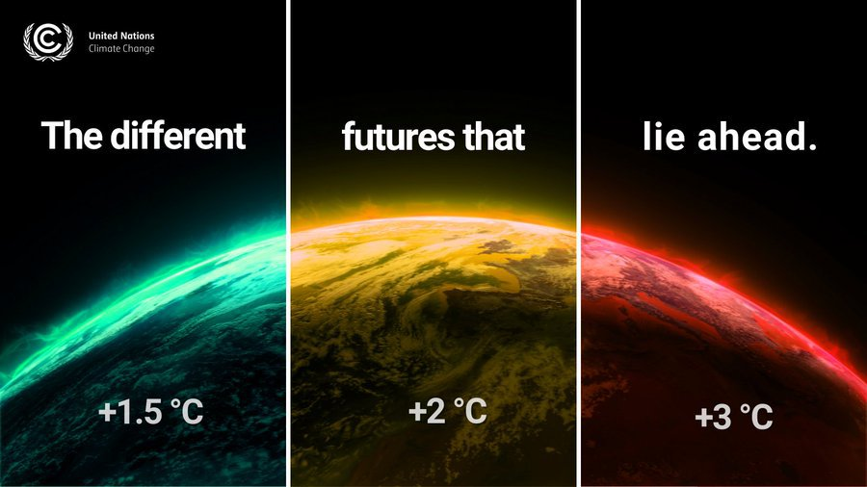

Slide 7
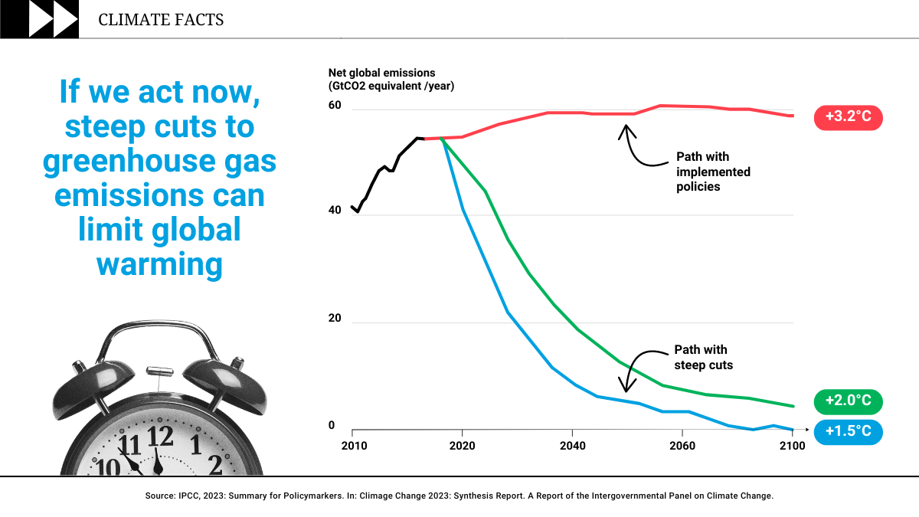

Slide 8
Work in Pairs
1.5°C: what it means and why it matters
The title 1.5°C - what it means and why it matters, the Climate Facts graph and the UN Climate Change infographic were produced following COP 2023.
Can you explain their significance?
What are Greenhouse Gases?
What is your carbon footprint?
Brainstorm ways an individual can mitigate climate change by reducing their carbon footprint
COP: Conference of the Parties of the United Nations Framework Convention on Climate Change
Notes:
See teacher notes for info / possible answers

Slide 9
Which lifestyle choices impact your carbon footprint the most & the least?
Form teams of 4. Choose a name for your team and assign a letter to each member: A, B, C, D. Choose a team leader, and a reporter.
Working in teams
Can you collaborate well in a group, as a participant, as a leader, and as a reporter?
Discussion
Which actions do you think impact the most and the least?
Notes:
Explain that they’re going to discuss which lifestyle choices impact most/least, but first you’d like them to think about how they work and collaborate in groups.
Ask them to work in groups and use the worksheet in the student pages.
Hopefully by asking them to think about participation beforehand, the groups will focus on the process, not just the task. Of categorising the cards under each heading.
The prompts below are about encouraging participation more than they are about “how do you say …?”
Give them 5 minutes to work through the questions and then move onto sorting the cards and the discussion. Return to levels of participation afterwards

Slide 10

Which lifestyle choices impact your carbon footprint the most & the least?
Against the clock
Low Impact
Moderate Impact
High Impact
Notes:
Have them study the 11 lifestyle choices on the cards (appendix 1), discuss and agree which would reduce their carbon footprint the most.
They have to divide the choices into 3 groups: low impact, moderate impact and high impact. When they have reached their conclusion, have them take a photo of where they have placed the cards, they then agree on their ‘Top 5’.

Slide 11
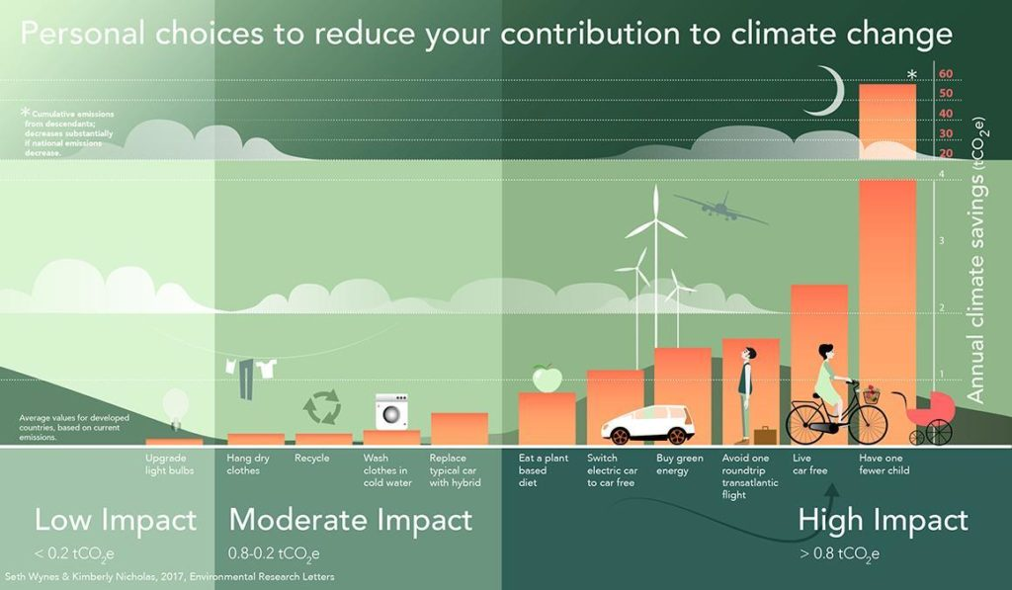

Slide 12
Analysing and interpreting an infographic
Compare the photo you took with the infographic. Were your ideas correct?
According to the graph, how could you summarise the lifestyle choices that most reduce your carbon footprint? How many tonnes of CO2 does each action save? Complete the table.
How important is this infographic? Are we simply putting different actions in the correct order or is there something more important here? What do you think?

Slide 13
Analysing and interpreting an infographic: Complete the table.
Lifestyle choices |  | Tonnes (tCO₂ e)
1 | Eat a plant-based diet | 0.8 p.a.
2 | Switch electric car to car free | 1.15 p.a.
3 | Buy green energy | 1.5 p.a.
4 | Avoid air travel | 1.6 return trip
5 | Live car-free | 2.4 p.a.
6 | Have smaller families | 58.6 p.a.

Slide 14
Analysing and interpreting an infographic
Compare the photo you took with the infographic. Were your ideas correct?
According to the graph how many tonnes of CO2 does each action save? Complete the table.
How important is this infographic? Are we simply putting different actions in the correct order or is there something more important here? What do you think?

Slide 15
Collaborating in &/or leading a group
Can you collaborate on a shared task: helping define goals, asking questions to stimulate discussion, focus or re-focus a discussion with suggestions and your opinion?
As the group leader, can you set ground rules in collaborative discussion? Can you intervene when necessary to encourage more even participation or to set a group back on task? Can you allocate the turn in a discussion, inviting a participant to say something?

Slide 16
Collaborating in &/or leading a group
How well can you collaborate well in a group, as a participant, and as a leader?
The team leader made sure everyone contributed to the discussion Yes / No
The team leader made sure we stayed on task Yes / No
The team leader asked us to give more information to support our answers Yes / No
We came to a decision on the impact of all 11 lifestyle choices Yes / No
Do you have any advice for your leader?
And how about you?
I gave my opinion Yes / No
I gave a reason for my opinion Yes / No

Slide 17
The Big 4
and missed opportunities
Reducing your Carbon Footprint: what really matters

Slide 18
The Big 4
The researchers who produced this infographic, refer to the big 4 high impact actions.
Which of the 6 high impacts actions do you think the big 4 are?
Notes:
Tell the class that the authors of this research talk about the “big 4” and elicit which they are:
The big 4: Eat a plant-based diet; Live car-free; Avoid air travel; Have smaller families
You can speculate “why those 4” - but they don’t actually say why they exclude switching from electric to car free or using green energy, perhaps the significance of transport or perhaps green energy is outside an individual’s control, although itr isn’t in the US

Slide 19
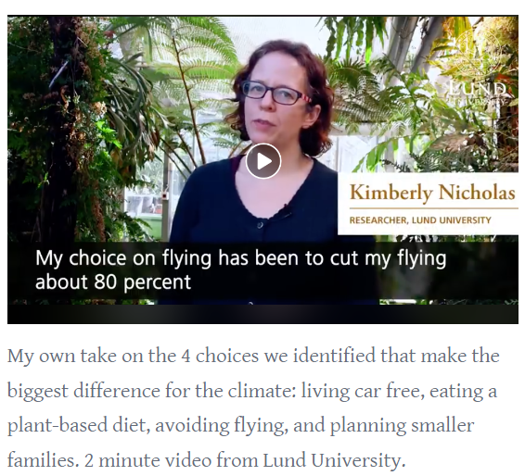
The Big 4
One of the two researchers, Kimberley Nicholas produced a video in which she reflected on her own choices regarding the big 4.
Watch the video, make notes and summarise what she says about each of the big 4.

Slide 20
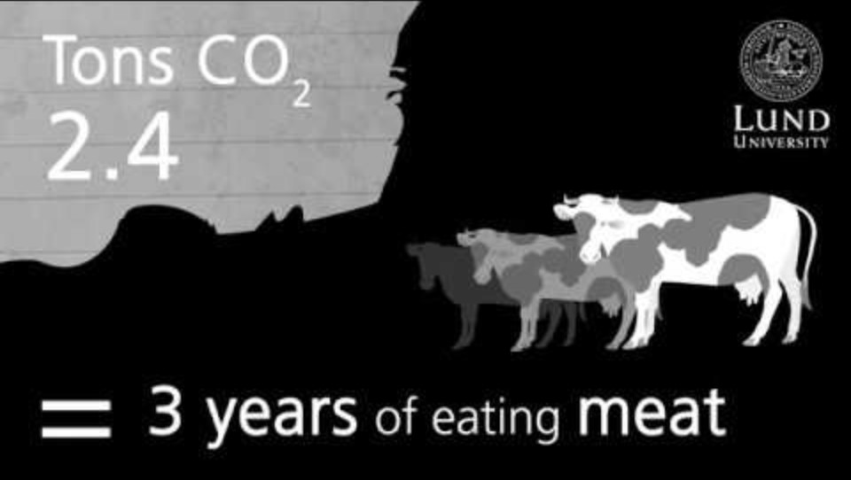
Kimberley Nicholas
Notes:
Note: decide in advance which slide to hide: slide 20 or 21.
Use slide 20 and the student page 4 (& hide slide 21) if you want the video viewing & notetaking to be whole class.
Use slide 21, and use appendix 4 along with student page 4, (and hide slide 20) if you want students to access the video on their own devices.

Slide 21
The Big 4
Which of the high impact actions do you do in your family?
Which of the moderate impact actions do you do in your family?
Which of the low impact actions do you do in your family?
Notes:
Personalise it by asking students to individually make notes about what they do in their family and discuss in their teams and then share their conclusions (rather than what each family does) with the whole class

Slide 22
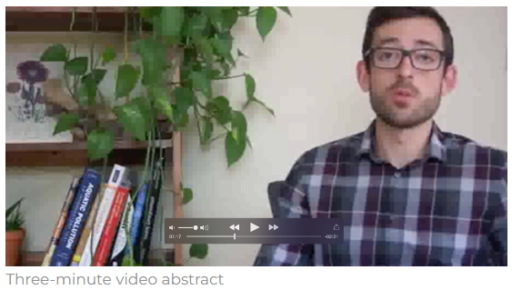
Missed opportunities or something else?
The other researcher of Mitigating Climate Change, Seth Wynes, produced a video on a different topic.
Watch the video, make notes and summarise his concerns

Slide 23
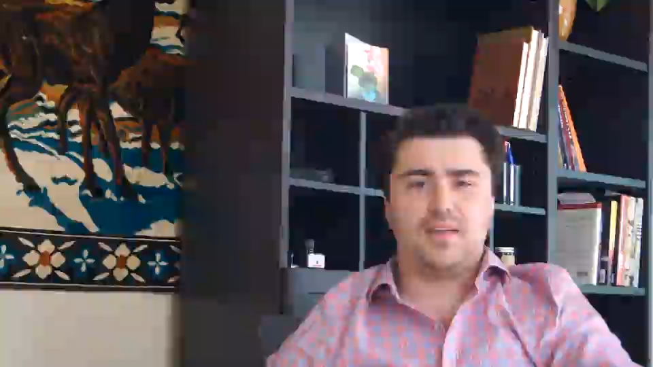

Slide 24
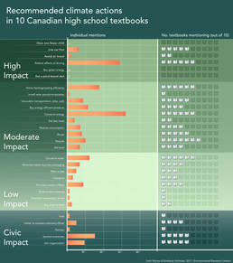
Missed opportunities or something else?
He produced an infographic to show how Canadian Highschool books featured Climate Change actions.
Can you use it to explain how the infographic shows his concerns?

Slide 25

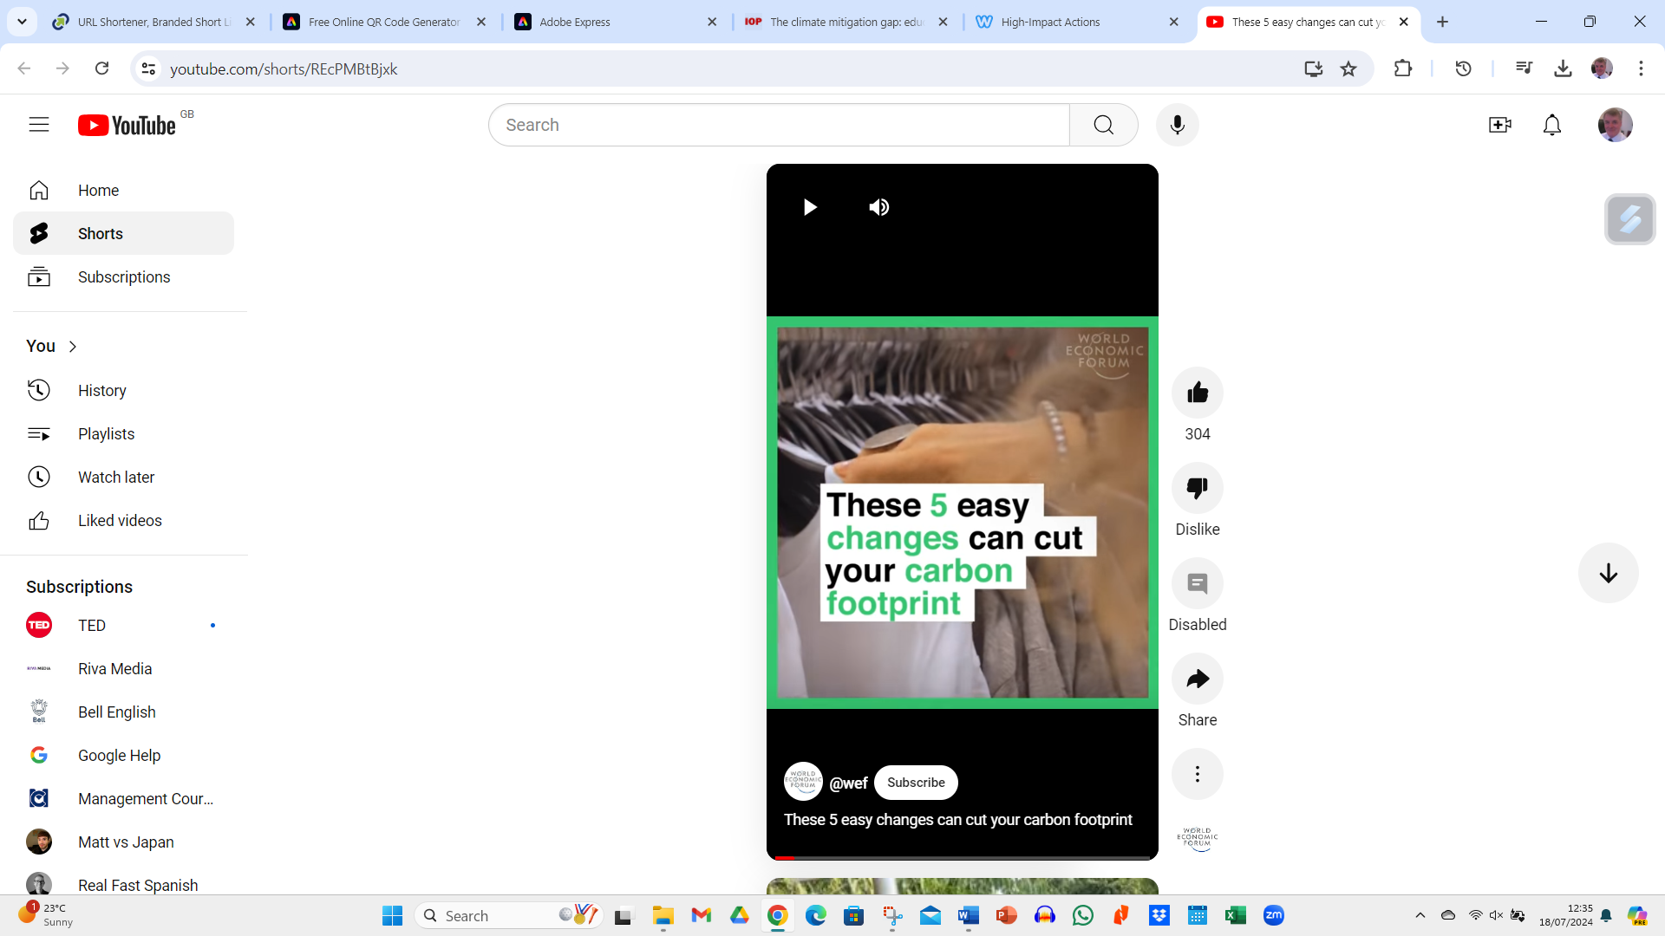
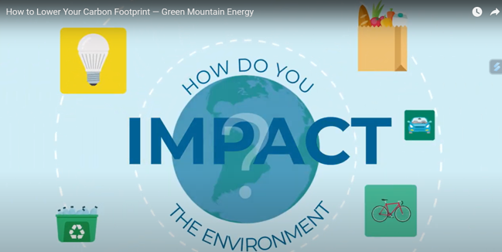


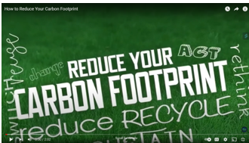
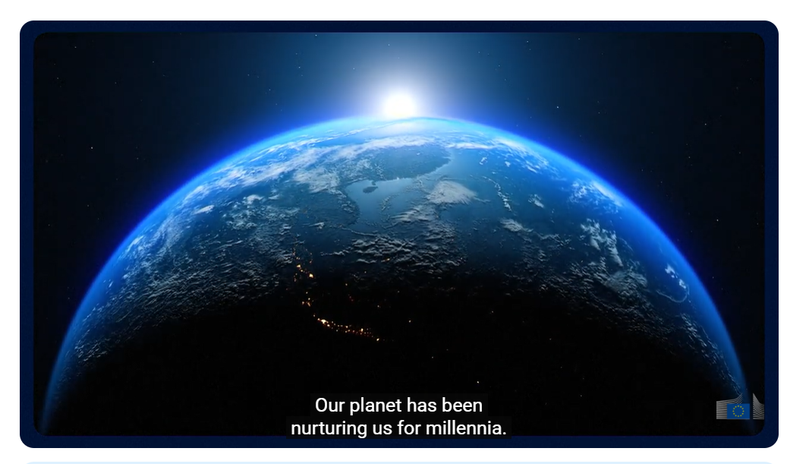

Homework: Missed opportunities or something else?
Group A
Group B
Group C
Group D

Slide 26
Explaining Data
in Writing
The Big 4
and missed opportunities

Slide 27
Homework: Missed opportunities or something else?
Group A
Group B
Group C
Group D

Slide 28
Explaining Data in Writing
Can you reliably interpret and present in written English detailed information from diagrams and visually organised data?
Work in pairs to answer the questions, and then, working individually use your answers to produce a detailed written explanation of the infographic.

Slide 29
Explaining Data in Writing
A. Introduction
Who are Seth & Kimberly?
What did they do?
Why? What were their aims?
B. Infographic
What is it a graph of?
What does it show? (overview)
What is on the X and Y axes?
How is CO₂ measured?
How are high, moderate and low actions defined, and how many of each are there?
What do the “notes” say?
C. Comparisons, implications, conclusions
What comparisons can you make?
What are the implications?
What conclusions can you draw?

Slide 30
Criteria for explaining data
 | Content: information, explanation and organisation | Language: vocabulary & grammar
4 | The infographic is accurately and fully described. The description is very well ordered and organised | Uses language to explain data very well. Simplifies and paraphrases very well. Very good range and control of vocabulary and grammar. almost no vocabulary, grammar , spelling or punctuation mistakes.
3 | It is accurate but some information is missing. The description is well ordered and organised | Uses language to explain data well. Simplifies and paraphrases well. Good range and control but noticeable mistakes in vocabulary, grammar , spelling or punctuation although none affect meaning
2 | It is mostly accurate, some information is missing, and some is incorrect. The description is not well ordered or organised but it is comprehensible | Can explain data but reader may struggle to understand. Has narrow range and control of vocabulary and grammar and mistakes are widespread
1 | The information given is mostly accurate, but significant information is missing and some of it is wrong. The description is not well ordered or organised and it is difficult to understand. | Can explain data but reader will struggle to understand. Has limited range and control of vocabulary and grammar, mistakes are widespread and affect meaning
0 | Cannot describe the infographic or The explanation is off-topic | Language level not up to the task

Slide 31
Analysis and reflections
Work in pairs
Analysis:
Read and discuss each other’s explanations.
Use the scoring criteria for explaining data and give each other a score from 4 > 0.
Reflections:
How easy was it to explain the infographic?
How well did you do?
What did you learn?
What could you do next time to improve?

